Slide 1
Xcrypt: Highly-productive
Parallel Script Language
Tasuku Hiraishi
Kyoto University

Slide 2
Background
Yet Another HPC Programming
Use of an HPC system for R&D ...
  is not just a single run of a HPC program
  but has many PDCA cycles with many runs
HPC application programming ...
  is not limited to from-scratch with Fortran, C(++), Java, ... and with MPI, OpenMP, XMP...
  but includes glue-programming for;
    do-parallel executions of a program
    interfacing programs and tools
    PDCA cycle management
    ...
plan-do-check-action

Slide 3
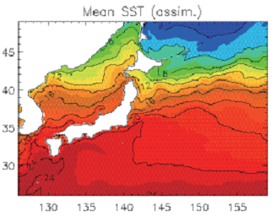
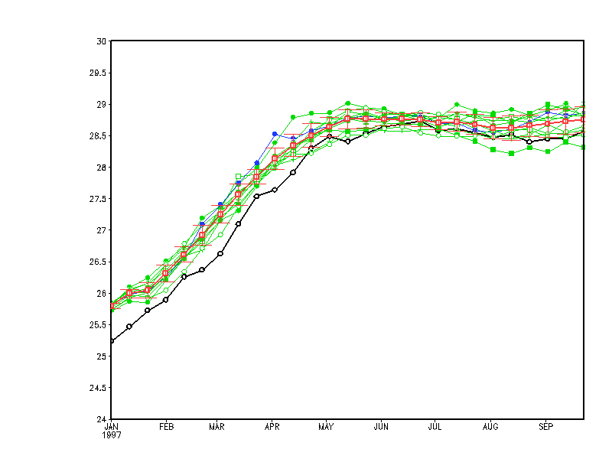
Yet Another HPC Programming
Example of C&C Computing
Oceanographic Simulation
  Capability Computing
    Navier-Stokes +
    Convective Heat Xfer + ....
    Fortran + MPI, of course
  Capacity Computing
    Ensemble Simulation with
    various initial/boundary
    conditions
    Fortran + MPI, why???
    ➔Not only unnecessary but also inefficient
    Do it with Script Language !!!

Slide 4

Yet Another HPC Programming
C&C with Script Language
Two-Layered Million-Scale Programming
⬅ 10³ capability x 10³ capacity = 10⁶
Script Program
for do-parallel exec
of parallel programs
lower layer
= capability type
= XcalableMP
upper layer
= capacity type
= Highly-Productive
Parallel Script Lang.
= Xcrypt

Slide 5
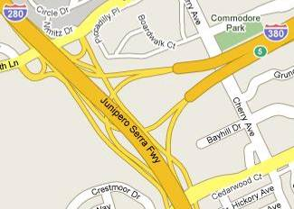
Yet Another HPC Programming
Goal=Automated PDCA Cycle
e.g. Ensemble-Based Data Assimilation
= repeated sim to find opt parameter
P: create huge size of input data
D: submit huge number of jobs
qsub sim p1
qsub sim p2
qsub sim p3
...
?
?
?
A: find the way to go next
C: check huge size of output data

Slide 6
Why DSL?
You can write in Perl or Ruby but…
It is annoying to implement by yourself
  Generating job scripts for a job scheduler
  (NQS, SGE, Torque, LSF, …)
  Managing (plenty of) asynchronously running jobs’ states,
  Waiting for the jobs finishing,
  Preparing (plenty of) input files,
  Analyzing (plenty of) output files,
  Specifying and retrying aborted jobs, …
→ It is not difficult but annoying task.

Slide 7
Yet Another HPC Programming
Goal=Automated PDCA Cycle
e.g. Ensemble-Based Data Assimilation
= repeated sim to find opt parameter
P: create huge size of input data
D: submit huge number of jobs
qsub sim p1
qsub sim p2
qsub sim p3
...
@params=
create_param(@space)
@results=
submit($job,@params)
%myPDCA = (
init_state => …,
exec_file => …,
evaluate => …,
explore => …
);
?
?
?
@space=
explore(@results)
@eval=
evaluate(@results)
A: find the way to go next
C: check huge size of output data

Slide 8
What is Xcrypt?
A job-level parallel script language that
release you from various annoying tasks.
  Generates job scripts
    You need not care about differences among various batch schedulers
    (NQS, Condor, Torque, …)
  Provides simple interfaces for submitting and waiting for (plenty of) jobs
Xcrypt is extensible
  Expert users can add various features to Xcrypt as modules

Slide 9
Xcrypt Programming
(Almost) Perl + Libraries + Runtime
  Xcrypt on other script languages
  (Ruby, Python, Lisp, … ) is under development
Job execution interfaces
  Job object creation: @jobs=prepare(%template);
    %template is an object that contains job parameters as members
    A sequence of jobs may be generated from a single template
  Job submission: submit(@jobs);
  Waiting for the job finished: sync(@jobs);

Slide 10
Xcrypt Script for a Parameter Sweep
use base qw(core);
%template = (
'RANGE0' => [0..999], # sweep range
'id@' => sub {"job$VALUE[0]"} # job’s ID
'exe0' => “calculate.exe", # execution file
'arg1@'=> sub{"input$VALUE[0].dat”} # input file
'arg2@'=> sub{"output$VALUE[0].dat”} # output file
'after'=> sub { # invoked after each job finished
$_->{result} = get_result($_->{arg2});
});
@jobs=prepare(%template); submit(@jobs); sync(@jobs);
my $sum=0; # sum up the jobs’ results
foreach my $j (@jobs) {
$sum += $j->{result};
}

Slide 11
Xcrypt Script for Graph Search using an Extension Module
use base qw (graph_search core); # use the extension module
%mySimulation = (
'exe' => ‘geom_optimize.exe’, # execution file
'arg1'=> ‘input.dat’, # input file
'arg2'=> ‘output.dat’, # output file
'initial_states'=>”molecule_conformation.dat”,
'before'=> sub { # invoked before submitting each job
choose a structure from state pool and generate “input.dat”
}
'after'=> sub { # invoked after each job finished
evaluate ”output.dat” and add new structures into state pool
}
'end_condition' => isStationary(),
);
prepare_submit_sync (%mySimulation);

Slide 12
Mechanism for extension modules
package core;
sub new {...}
sub qsub {...}
sub qdel {...}
job scheduler via
job management
module
extend
extend
package limit;
use base qw(core);
sub new {...}
sub initially {...}
sub finally {...}
package graph_search;
use base qw(core);
sub new {...}
sub before {...}
sub after {...}
sub start {...}
extend
package user;
use base qw (limit graph_search core);
prepare_submit_sync (
...
);
extend

Slide 13
Spawn-sync style notation
use base qw(core);
sub analyze {
analyze output file (application dependent)
}
foreach $i (0..999) {
spawn { # executed in a concurrent job
system ("calcuate.exe input$i.dat output$i.dat");
analyze("output$i.dat"); # time-consuming post processing
} (JS_node=> 1, JS_cpu => 16);
}
sync;

Slide 14

Fault Resilience
Xcrypt can restore the original state quickly even if jobs or Xcrypt itself aborted
You can also retry some finished jobs after cancelling them and modifying conditions
  You have only to re-execute Xcrypt
  Then, Xcrypt skips finished (part of) jobs

Slide 15
File generation/extraction
Input file generator / Output file extractor
  Higher level interface than sed/grep
    e.g. FORTRAN namelist specific
  Runs in parallel as part of jobs
  with referring to variables defined in Xcrypt
Example
  $in->replace_key_value(‘param’, 30);
    Replace the value of ‘param’ in the FORTRAN namelist
  $out->extract_line_rn(‘finish‘, -1);
    Get the lines that include ‘finish’ and their previous lines.

Slide 16
Remote job submission
Remote job submission
  Submit jobs from Xcrypt on your laptop PC
  Enables job parallel processing among multiple supercomputers by a single script
APIs for transferring files from/to remote login nodes.

Slide 17
Example (remote submission)
my $env1 = &add_host({
'host' => ‘tasuku@t2k.ccs.tsukuba.ac.jp',
'sched' => 't2k_tsukuba'});
put_into ($env1, ‘input.txt’)
&prepare_submit_sync = (
'id' => 'jobremote',
'JS_cpu' => '1',
'JS_memory' => '1GB',
'JS_limit_time' => 300,
'exe0' => ‘./a.out’,
'env' => $env1,);
get_from ($env1, ‘output.txt’);

Slide 18
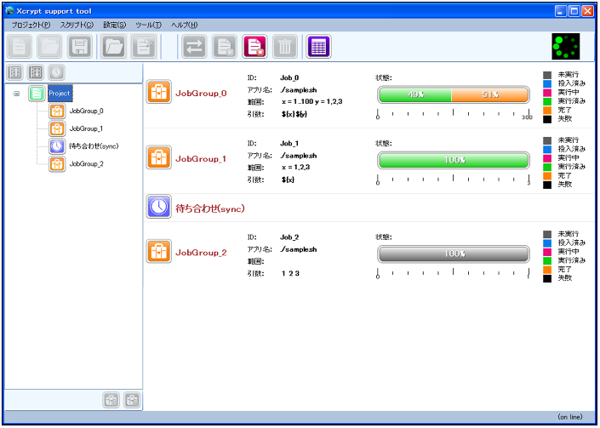
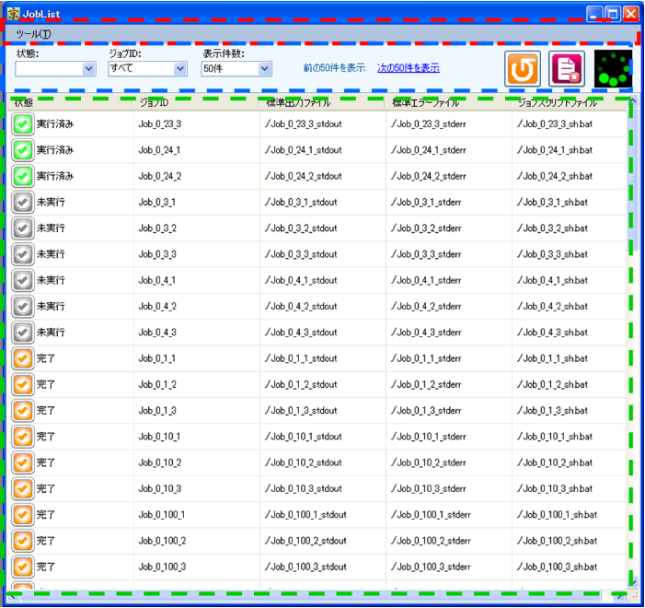
GUI for Xcrypt

Slide 19
Features of Xcrypt GUI
Setup Xcrypt on your login node
Create Xcrypt script on GUI (only very simple script)
Remotely executes Xcrypt on your login node
Shows the progress of submitted jobs graphically
Enables us to access input/output files and Xcrypt script files easily from the status window

Slide 20
Practical Applications
Performance Tuning for electromagnetic field analysis program
Probabilistic search of the optimal simulation parameter for galaxy simulations
Parallel executions of jobs depending on each other in atomic collision simulation

Slide 21
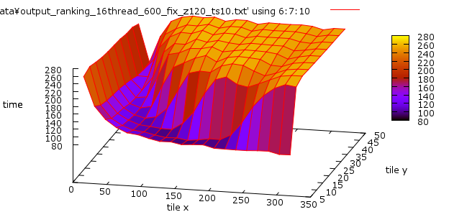
App1: Performance Tuning
Runs the program with various values of performance parameter
  Tile size (Tx, Ty, Tz)
  # of tiling steps (Ts)
The optimal value
depends on architecture:
cache size, # way, …
Space selection→sweep→selection→…
Got better performance than hand-tuning.

Slide 22
App2: Probabilistic Search
Input: simulation parameter
The program evaluates how close the model based on the parameter is to the observed galaxy.
Output: score
Find the optimal value with a probabilistic search

Slide 23
(Parallel) Monte Carlo Method
A job execution
Execute in parallel
# steps

Slide 24
Marcov Chain Monte Carlo Method
(MCMC)
The next parameter value
depends on the previous result
# steps

Slide 25
Marcov Chain Monte Carlo Method
(MCMC)
T4
Temperature
T3
T2
T1
# steps

Slide 26
Replica-Exchange Marcov Chain Monte Carlo Method (RE-MCMC)
Exchange values
between temparatures
T4
Temperature
T3
T2
T1
# steps

Slide 27
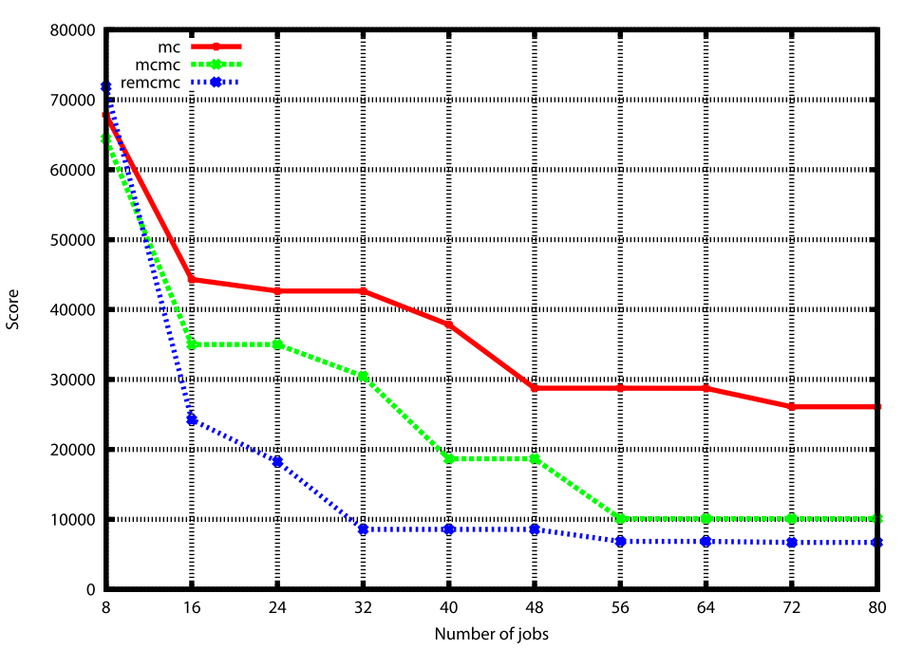
Search Result
(8 temperatures in parallel)

Slide 28
App3: Atomic Collision Simulation
A number of Atomic
collision occur in a
simulation space
A single run simulates
one collision behavior
Collisions on a small
distance are depend
on each other
Other collisions can be simulated in parallel
They want to execute simulations in parallel as much as possible
Work-in-progress

Slide 29
The “dependency” module
Enables to write dependency among jobs declaratively
  $j1->{depend_on} = [$j2, $j3];
  When the job $j1 is finished, we can execute $j2 and $j3
  When $j1 is aborted, we also make $j2 and $j3 aborted

Slide 30
Xcrypt in the future
Xcrypt on the “K Computer”
Multilingualization

Slide 31
Xcrypt on the “K Computer”
We expect there are little difficulty to use Xcrypt on K
The specification details have not been revealed now…
  Do we need staging?
    Xcrypt already supports staging by the extension module
  Can we specify a geometrical form of computation nodes?
    We can support in a system configuration script
  Does Perl run on login/computation node?
    Even if not, we can use remote submission
    The “spawn” feature cannot be used…

Slide 32
Multilingualization
Now Xcrypt is provided as an extended Perl
Some users want to write scripts in Ruby, Python, Haskell, Lisp, …
submit (jobs);
map submit jobs
(mapcar #’submit jobs)

Slide 33
Selection of design
Re-implement Xcrypt in Ruby (etc.) ?
  Non-productive
Just provide wrappers?
  Very easy to implement
  Cannot reuse extension modules defined in Perl
  Pre/Post-processing of jobs defined as Ruby function cannot be called from the “submit” function implemented in Perl
Develop a foreign function interface (FFI) between Perl and other langs!
  Less productive but once the design is fixed,
  we can implement interfaces for other langs easily

Slide 34
Implementation Overview
TCP connection
Ruby process
Perl (Xcrypt) process
job = prepare ({
id => “myjob”,
exe0 => “./a.out”,
before => lambda { … },});
submit (job);
sync (job);
Dispatcher
thread
・・・
Dispatcher
thread
Job object
id: ‘myjob’
exe0: ‘./a.out’
before: sub {rcall(‘lam1’)}
Send function name serialized
parameters
A pair of the unnamed function
and new generated ID is stored
in Ruby and only the ID is sent.
→ converted to a Perl function
that invokes a remote call
・・・
‘lam1’:
・・・
Send the serialized result
A pair of the job’s ID and
the reference to the job
object is stored in Perl
and only ID is sent
‘prepare’
thread
‘myjob’:

Slide 35
Implementation Overview
TCP connection
Ruby process
Perl (Xcrypt) process
job = prepare ({
id => “myjob”,
exe0 => “./a.out”,
before => lambda { … },});
submit (job);
sync (job);
Dispatcher
thread
‘lam1’
thread
・・・
Dispatcher
thread
Job object
id: ‘myjob’
exe0: ‘./a.out’
before: sub {rcall(‘lam1’)}
Only the ID ‘mjob’ is sent
Perl can specify the job object
by referring to the hash table
・・・
‘lam1’:
Invoke a remote call for the
‘before’ process.
Only the ID ‘lam1’ is sent
Ruby can specify the unnamed
function by referring to the
hash table
job ‘myjob’
thread
・・・
‘submit’
thread
‘myjob’:

Slide 36
Summary
Xcrypt: a portable, flexible, and
easy-to-write script language
for job-level parallel processing
  Higher level APIs for submitting jobs
  Higher level job management
  Many advanced features
Xcrypt is now available at
http://super.para.media.kyoto-u.ac.jp/xcrypt/

Slide 37
Applications
Finding the optimal amount of emitting negative ions using the bisection method for the spacecraft charging problem in space plasmas
Software automatic tuning
  Find the best performance parameter value
  (e.g. compiler optimization options, parameters for HPL)

Slide 38
HP&P Script Language
Design Concept
Must not be MS-Word
  easy-to-write does not mean nothing-to-write.
Must not be T_{E}X
  rich functionality does not mean do-it-yourself for everything.
So L T_{E}X in some sense
  reasonably easy-to-write and reasonably customizable.
  encourages style-file wizards with powerful built-ins and well-designed standard interfaces.
A

Slide 39
HP&P Script Language
Design Goal
Easy-to-Write
  even for guys who never hear of regular expressions, object-oriented, ...
  not requiring more than 10 lines for simple parameter sweeps.
Rich Functionality
  to implement easy-to-write magic by wizards who supports Muggles.
  to glue applications and GUI (if you love it), visualization tools, data capture tools, ...

Slide 40
HP&P Script Language
Why Xcrypt is HP & P
Script Language
  inherently suitable for programming to run programs
  rich functionality for gluing programs
  easy-to-write for computer scientists
Parallel Script Language
  feautres to run programs in parallel
  e.g. submit many jobs and wait for their completion
Highly-Productive Parallel Script Language
  easy-to-write for computational scientists
    create input files from a template easily
    extract desired lines/words from output files easily

